Slide 1


Get your year 7 class singing
Rebecca Berkley 13.00-14.00

Slide 2
Get your year 7 class singing
Dr Rebecca Berkley
Associate Professor in Music Education
Institute of Education, University of Reading
r.m.berkley@reading.ac.uk
Teacher education
Choral pedagogy
Classroom Musicianship
Curriculum Design
Get to know you
Warm up body and voice
Copy it - Move it
Finding your voice
Adolescent voices
Warm down
2

Slide 3
Get to know you
Clapping practice
I’ll say hello
Sing – dance – move your body

Slide 4
Warm up body and voice
Align and balance the body – feet, torso, arms, shoulders, neck, head
Breathing – jar of air, jar of fricatives, jar of vowels
Vocal folds – take a line for a walk (ng, fricatives, tongue and lip trills, puffy cheeks, pigeon)
Tongue and teeth – tongue twisters, diddle-dee

Slide 5
Copy it – move it
Throw and catch
Bim Bom Biddy

Slide 6
50 Fabulous musical words
adagio
andante
walking
moderato
skipping
allegro
running
vivace
very fast
slow
Getting slower
Getting faster
Rallentando (slowing down)
Ritardando (holding back)
Accelerando (getting faster)

Slide 7
50 Fabulous musical words
pianissimo
piano
mezzo piano
pp
very soft
p
soft
mp
quite soft
mezzo forte
mf
quite loud
forte
fortissimo
f
loud
ff
very loud
Getting softer
Getting louder
Diminuendo
Crescendo

Slide 8
Finding your voice
A cat meditating
Rocka my soul
Teaching
Demonstrate and model
My turn – your turn, pitch pattern, steady pulse
Know your repertoire
Incremental steps for learning, improvement and challenge

Slide 9
A cat meditating
X X A cat X X meditating X X on a railway track
X X Cat, X you better get X X you betta get back
Don’t do that X X
Learn bass part for unison singing
Learn middle and upper parts for 3 part singing
Canon at 2 beats (if you count in crotchets)
Listen and copy
Sing and clap
Sing bass and middle part in rhythmic unison
Sing bass, middle and upper parts in rhythm unison
Bass line only
bass with middle and upper as echo

Slide 10
Rocka my soul
Rocka my soul in the bosom of Abraham (x3)
X Oh, rocka my soul, alleluia
Rock my soul, yes rock my soul (x3)
X Oh rocka my soul
So high I can’t get over it
So low I can’t get under it
So wide I can’t get round it
Gotta go through the door
Partner songs – independent melody to hand onto in a 2 and 3 part texture
All songs are within an octave range, but different pitches for the changing voice

Slide 11
Adolescent voices
Changes in the voice are caused by changing hormone levels, mirroring physical growth spurts starting with the feet, then the long bones, and then laryngeal cartilages
Typically, the mean vocal fold length will thicken and increase by 66% in males, and 24% in females during puberty
Voice change is gradual over (typically) 2 years some time between age 12 – 15 for males, and 10 – 15 in girls, plus two years on either side
Voice change is active in growth spurts then plateaus. Huskiness, reduced range, vocal fatigue can occur in active voice change and then reduce during plateaus

Slide 12
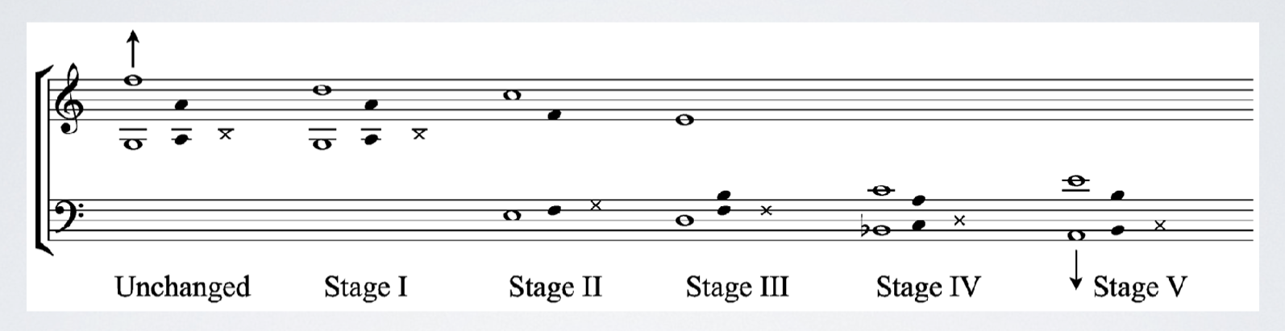
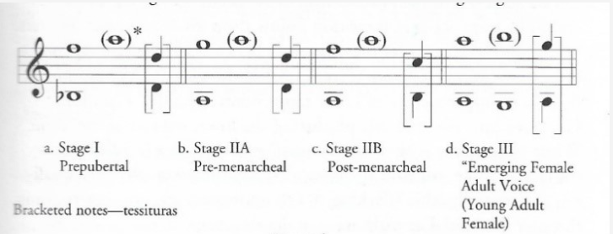

Adolescent voices
Male
Female
X = speaking pitch
Filled notes = comfortable singing range
Empty notes = extended singing range

Slide 13

Warm down
ng, fricatives, tongue and lip trills, puffy cheeks, pigeon

Slide 14


Slide 15


