Slide 1


Supporting non specialists to deliver successful music lessons
Rebecca Berkley 11.00-12.00

Slide 2
Supporting non specialists to deliver successful music lessons
Dr Rebecca Berkley
Associate Professor in Music Education
Institute of Education, University of Reading
r.m.berkley@reading.ac.uk
Teacher education
Choral pedagogy
Classroom Musicianship
Curriculum Design
Today we are going to
Explore teaching listening in primary music lessons, based on the BBC Ten Pieces In the Hall of the Mountain King
Model ways of teaching listening through movement, invention and performance
Model effective questioning to help children listen analytically and articulate what they know
Introduce you to some musical terms – which you probably already know!
2

Slide 3
You are a year 4 class, you already know:
Music has a steady beat. The beat goes at different speeds (tempi) and we use English and Italian words to describe this
Music can be different volumes (dynamics), and we use English and Italian words to describe this
The rhythm is the pattern of the words in a song. You can read and play these rhythms:
 | Looks like | and we say | and its rhythm name is
One rhythm sound on a beat | g | ta | crotchet
Two even rhythm sounds on a beat | h | ti-ti | quavers
No rhythm sound on a beat | Z | sh | crotchet (or ta) rest

Slide 4
Rumble - explosion

Slide 5



In the Hall of the Mountain King

Slide 6
Tiptoe – walking – running fingers
Scary fingers
hhhg | hg hg | hhhh | hhg Z
hhhg | hg hg | hhhg | hhg Z

Slide 7
Rumble - explosion

Slide 8
In the Hall of the Mountain King

Slide 9
If you were the children in this class…
How did you learn?
How were you taught?
How did you show me what you knew in music?
How did I used questions to understand your learning?

Slide 10
Active listening
Teaching children to listen with concentration and understanding (KS1 Music NC)
Active listening – combining listening with other activities to focus children on creative, non-verbal responses to music
Teaching focused listening
  Play classroom listening games to help children focus
  Check your audio equipment works
  Remove other distractions
  Do not talk over the music or allow children to talk
  Repeated listening of short extracts (30-90 seconds) - Play three times with minimal gap between each playing
  Allow children to complete their non-verbal response before moving to talking about this

Slide 11
Innocent ears
Innocent ears – a wide range of responses
No one *right* answer - Let the children explore how the music makes them feel so they can determine what the music inspires them to do in their own creative responses.
A child’s verbal response to music requires them to identify, discriminate and analyse in spoken language what they are hearing and their non-verbal responses to the music.
‘Articulate and justify answers, arguments and opinions; and give well-structured descriptions, explanations and narratives for different purposes, including for expressing feelings’ (English National Curriculum: Statutory guidance for spoken language).
Questioning facilitates focus on the quality of the sound and helps children to analyse the effect of combinations of sounds in the musical texture.

Slide 12
Sentence strings
I can hear …… in the music
This part of the music sounds louder (or softer, faster, slower, happier, more mysterious etc.) than the other part because….
This music sounds like …. because I can hear….
I think the music is telling the story of… because I can hear…..
Questioning script for analytical listening
Is there a place in the music where we hear the scary fingers sound? (or a soft sound, or a far away sound, or a mysterious sound etc.)
Where is the place we can hear the scary fingers sound?
What happens in the music to make that scary fingers sound?

Slide 13
What am I listening to?
 | Answering questions like
Identify sounds, musical elements and ideas | What instruments are playing? What are the memorable melodies in this music?
Discriminate between different musical sounds and ideas | Which instrument is playing the melody? How does the melody change each time that you hear it in the music?
Analyse how the musical sounds and ideas are put together in this music | How typical is this kind of melody compared to other music by this composer? What are the similarities between the melodies in the opening section the music, and the rest of the piece?
Appraise the effect of this combination of musical sounds and ideas. | What does this melody represent in the music? What questions would you ask the composer to find out more about their personal composing style

Slide 14
Spoken language years 1-6 (English NC)
Pupils should be taught to:
listen and respond appropriately to adults and their peers
ask relevant questions to extend their understanding and knowledge
use relevant strategies to build their vocabulary
articulate and justify answers, arguments and opinions
give well-structured descriptions, explanations and narratives for different purposes, including for expressing feelings
maintain attention and participate actively in collaborative conversations, staying on topic and initiating and responding to comments
use spoken language to develop understanding through speculating, hypothesising, imagining and exploring ideas
speak audibly and fluently with an increasing command of Standard English
participate in discussions, presentations, performances, role play/improvisations and debates
gain, maintain and monitor the interest of the listener(s)
consider and evaluate different viewpoints, attending to and building on the contributions of others
select and use appropriate registers for effective communication

Slide 15
50 Fabulous musical words
Concept | Meaning | Musical vocabulary includes…
Pitch | The frequency of an individual note (measured in Hz) or a group of notes | Essential: High and low; Pitch contours – drawing shapes; Melody and motif; Letter names for notes: A, B, C, D, E, F, G, or solfa Desirable: Notes in the treble (and bass) clef; Sharps and flats; Scales and modes
Pulse | The regular beat we perceive in music | Essential: Pulse, beat, rhythm; Tempo – the speed of the pulse, common Italian terms for tempo, metronome markings; Rhythm notation (crotchets, quavers, rhythm grids) Desirable: Time signatures, changing tempo
Timbre | The quality of a sound or group of sounds | Essential: Names of instruments and voices; Dynamics (volume of the music) Desirable: Identifying instruments and voices in ensembles, such as choir, orchestra, string quartet, swing band, rock band

Slide 16
50 Fabulous musical words
Concept | Meaning | Musical vocabulary includes…
Structure | The overall (macro) pattern or shape of a piece of music | Essential: Beginning, middle, end; Commonly used structural terms such as verse, chorus, introduction, ending, middle eight, Theme 1, theme 2 etc. Desirable: Binary (A:B) and ternary (ABA) form; Rondo
Texture | The number of individual lines or strands in a piece of music | Essential: Layers; Tune, accompaniment, ostinato, bass line Desirable: Analytic speaking and writing about how the layers in the music fit together
Context | The place and time the music was composed | Identifying the composer, and contextual details of the place and time the music was created

Slide 17
50 Fabulous musical words
adagio
andante
walking
moderato
skipping
allegro
running
vivace
very fast
slow
Getting slower
Getting faster
Rallentando (slowing down)
Ritardando (holding back)
Accelerando (getting faster)

Slide 18
50 Fabulous musical words
pianissimo
piano
mezzo piano
pp
very soft
p
soft
mp
quite soft
mezzo forte
mf
quite loud
forte
fortissimo
f
loud
ff
very loud
Getting softer
Getting louder
Diminuendo
Crescendo

Slide 19
50 Fabulous musical words
Concept | Meaning | Musical vocabulary includes…
Musical activity words | What we do in music lessons | listen, explore, share, respond, sing, play, move, invent, improvise, compose, perform, analyse
Musical expression words | How to describe what we hear | angry, scary, cold, icy, gentle, smooth, soft, even, shiny, twinkling, detached, distant, spiky, crash, bang(ing) smooth, soft, even, shiny, twinkling, detached, soaring, flying, swirling, misty and so on

Slide 20
Musical concept pairs
sound silence
start stop
beat rhythm
long sound short sound
fast slow
faster slower
high low
up down
loud soft
louder softer
big sounds little sounds
near sound far away sounds
smooth detached
wood metal
tuned untuned
instruments singing
solo group

Slide 21
In the Hall of the Mountain King

Slide 22
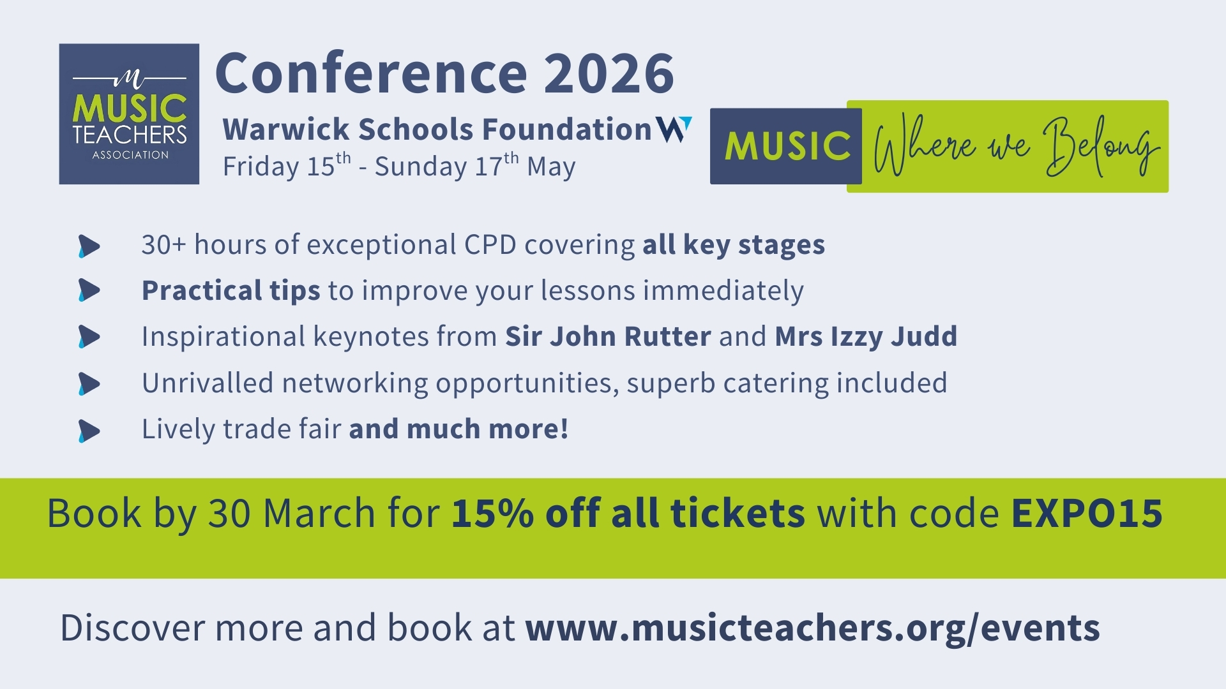

Slide 23
